Slide 1
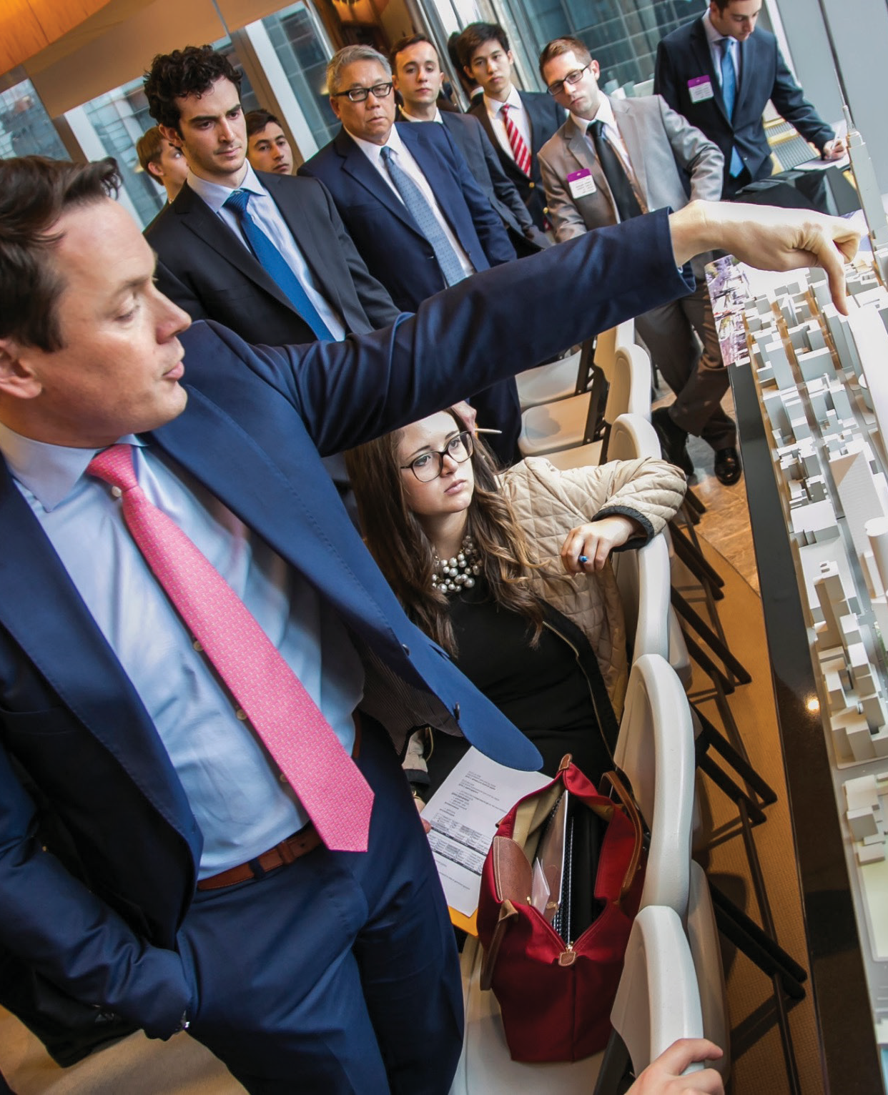
Come Experience the Hotelie Adventure
John Peterson ’03
VP of Related Urban
Tuesday, July 7 12:00 p.m.
7 East Ave
Lunch provided
His skills and passion for excellence of have enabled him to be a leading force behind the largest real estate deal in the history of our country, EVER.

