Slide 1
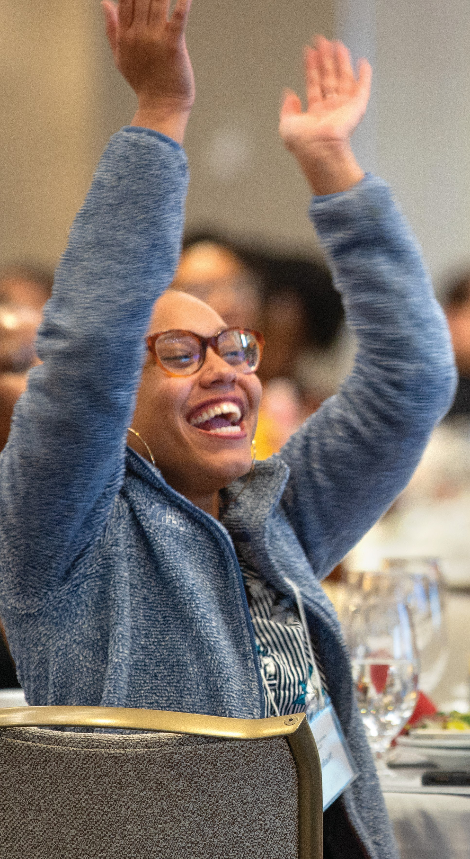
Faculty and Student
Award Celebration
Come and congratulate our student and faculty award winners!
Faculty Teaching Excellence Awards | Drown Prize | KOPF & Banfi Prizes | Merrill Presidential Scholars | PIHE Business Plan Competition | and many more!
Thursday, February 19
9:00 - 11:00 a.m.
11:00 a.m. - 1:00 p.m.
Statler Hall Auditorium

