Slide 1
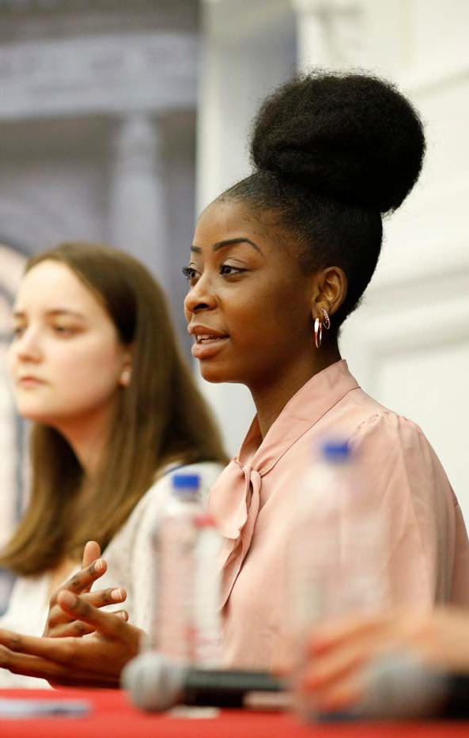


Dyson Reunion Luncheon with Dean Zhao
JUNE 7, 2024 | WARREN HALL 401
Coming back to Ithaca for Reunion? Be sure to join Dean Jinhua Zhao for a Dyson Reunion Luncheon in Warren Hall.

Slide 2
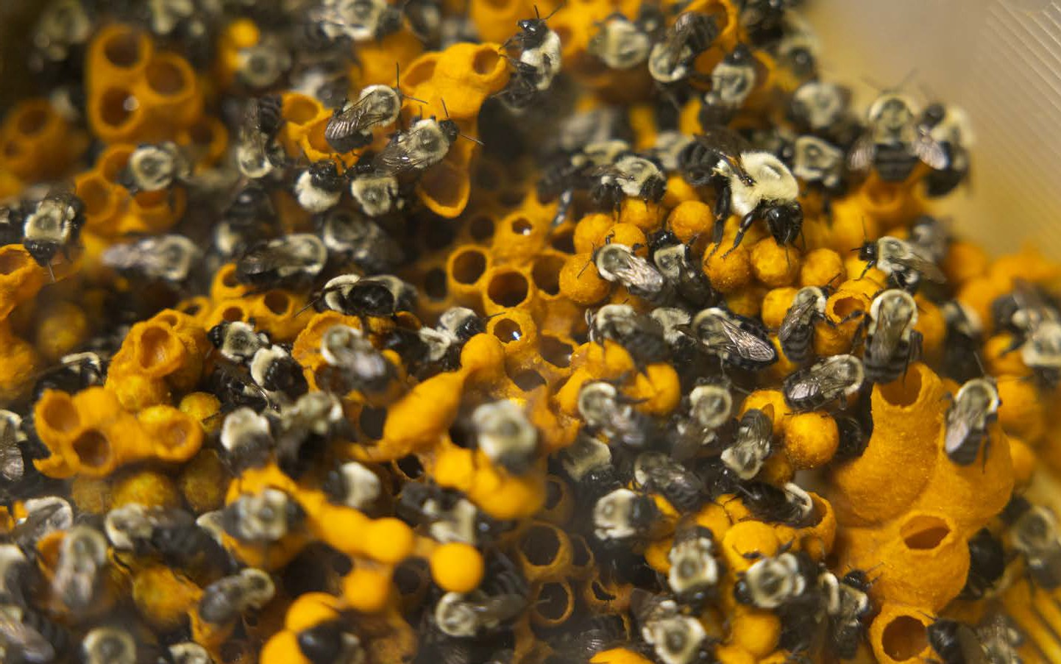

Beekeeping Lecture
COLLEGE OF AGRICULTURE AND LIFE SCIENCES (CALS)
Immerse yourself in the life of bees! Join Senior Lecturer Heather Grab on Thursday, February 19 in the lab in Comstack Hall for a first-hand look at these amazing insects.
Thursday, February 19
9:00 - 11:00 a.m.
11:00 a.m. - 1:00 p.m.
Comstock Hall

Slide 3
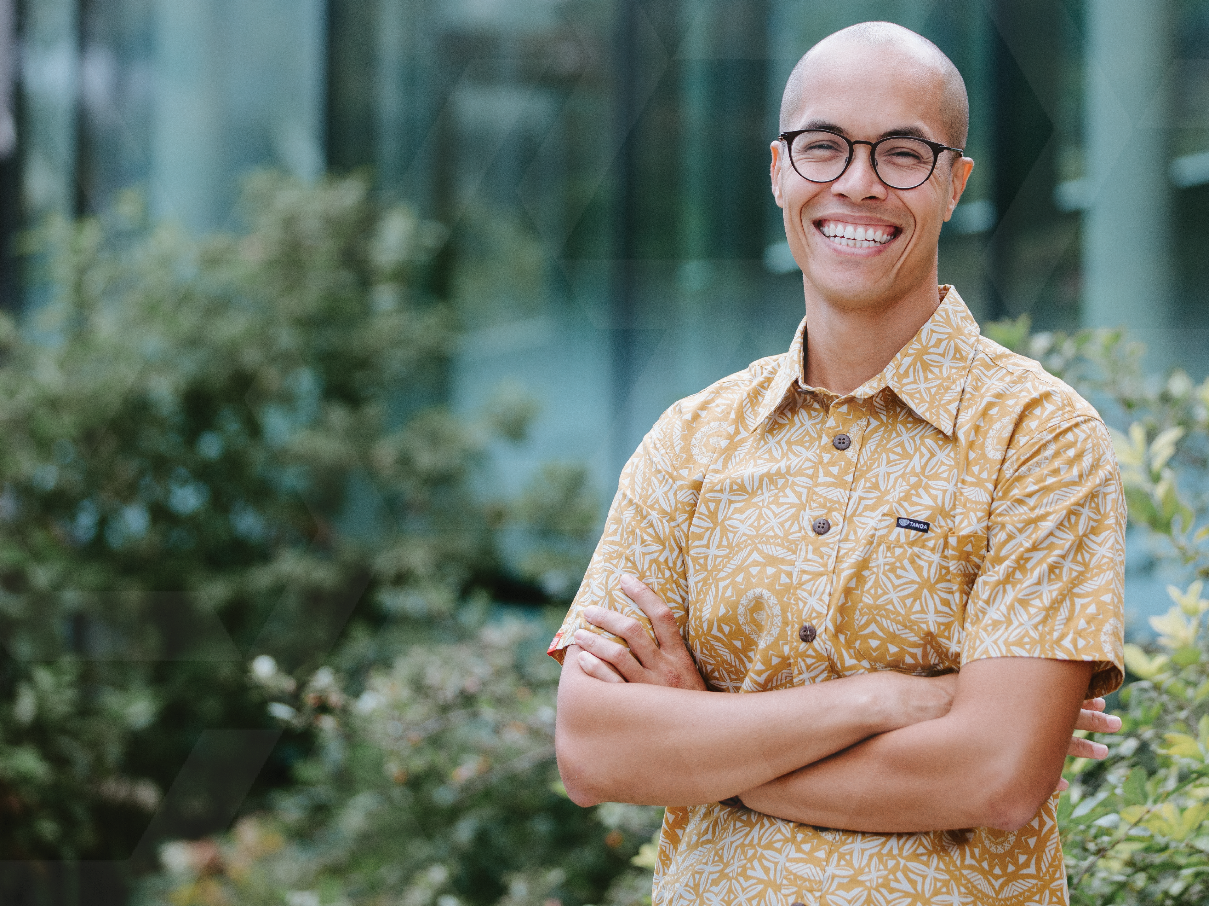

Edit sitia
Nonsed quam que vent qu
May 22, 2024
1:00 - 5:00 p.m.
Statler Auditorium Statler Hall Cornell University

Slide 4
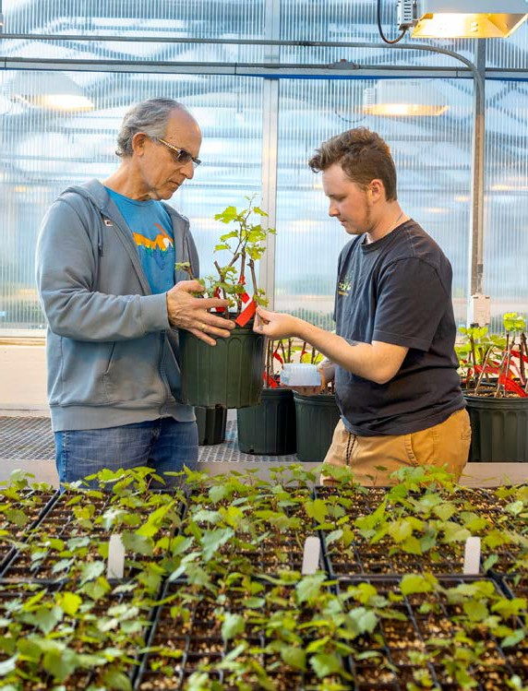



FACULTY AND STUDENT
Award Celebration
Come and congratulate
our student and faculty award winners!
Faculty Teaching Excellence Awards | Drown Prize | KOPF & Banfi Prizes | Merrill Presidential Scholars | PIHE Business Plan Competition | and many more!
Thursday, February 19
9:00 - 11:00 a.m.
11:00 a.m. - 1:00 p.m.
Statler Hall Auditorium

Slide 5
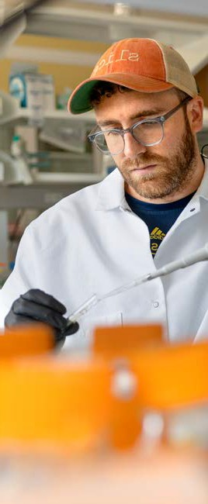
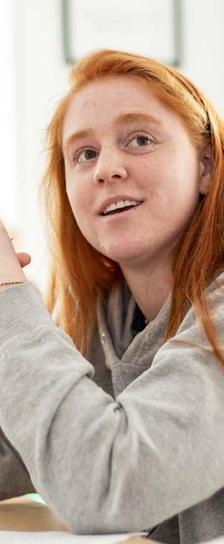
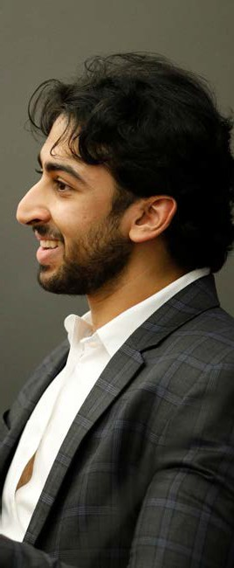

Student Awards
Thursday, February 19
9:00 - 11:00 a.m.
11:00 a.m. - 1:00 p.m.
Statler Hotel Amphitheater
Faculty Teaching Excellence Awards | Drown Prize | KOPF & Banfi Prizes | Merrill Presidential Scholars | PIHE Business Plan Competition | and many more!
Brought to you by the Office of Marketing and Communications

Slide 6
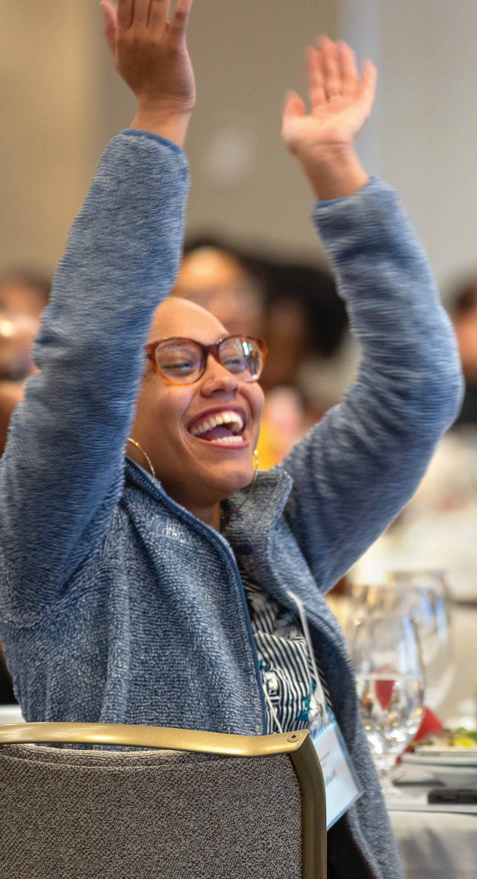

Faculty and Student
Award Celebration
Come and congratulate
our student and faculty award winners!
Faculty Teaching Excellence Awards | Drown Prize | KOPF & Banfi Prizes | Merrill Presidential Scholars | PIHE Business Plan Competition | and many more!
Thursday, February 19
9:00 - 11:00 a.m.
11:00 a.m. - 1:00 p.m.
Statler Hall Auditorium

Slide 7



John Smith
Manager, Operations
Mary Smith
Manager, Marketing
Janelle Smith
Consultant, Direct
Title, topic of presentation
October 11, 2021, 6:00-8:30 p.m., Room 223

